Slide 1

Hunger in America
Ann Rumsey

Slide 2
Capstone project
Link to Git Hub
Link to Power BI
Link to Tableau

Slide 3
Agenda
Tools used Python, Power BI, Tableau, Excel
To use a correlation plot I installed an R package in Power BI
Data sets from USDA (United States Department of Agriculture)
SNAP - Supplemental Nutrition Assistance Program
Food expenditures
Census data and projections

Slide 4
The first National Food Stamp program
Established in 1939 to combat hunger during high unemployment
"We got a picture of a gorge, with farm surpluses on one cliff and under-nourished city folks with outstretched hands on the other. We set out to find a practical way to build a bridge across that chasm."
(Milo Perkins, the Food Stamp program’s first administrator)

Slide 5
From Food Stamps to Snap - Supplemental Nutrition Assistance Program
Food Stamp program re-established in 1964 for a half-million recipients that first year, going nationwide in 1974 and growing to 22 million in 1981,
adding electronic benefit access in 1984, and peaking at 47 million in 2013,
then declining to the current level with 37 million SNAP recipients in February 2020.

Slide 6
Snap - Supplemental Nutrition Assistance Program - USDA
School Lunch program established in 1946, providing nutritionally balanced, low-cost or free lunches to children each school day
School Breakfast Program (SBP) provides reimbursement to states to operate nonprofit breakfast programs in schools and residential childcare institutions.
The Special Milk Program (SMP) provides milk to children in schools and childcare institutions who do not participate in other federal meal service programs.
The Child and Adult Care Food Program (CACFP) is a federal program that provides reimbursements for nutritious meals and snacks to eligible children and adults who are enrolled for care at participating child care centers, day care homes, and adult day care centers.
From <https://www.fns.usda.gov/cn>

Slide 7
Snap - Supplemental Nutrition Assistance Program

Slide 8
Timeline

Slide 10
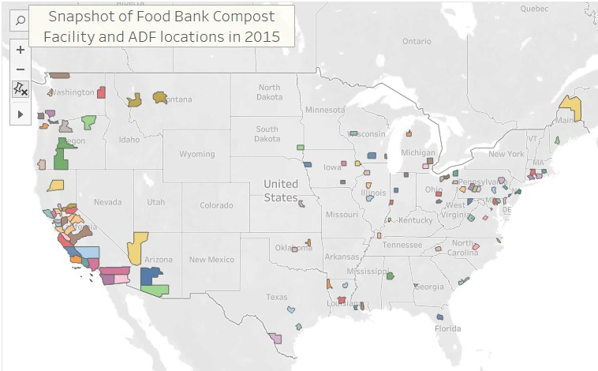
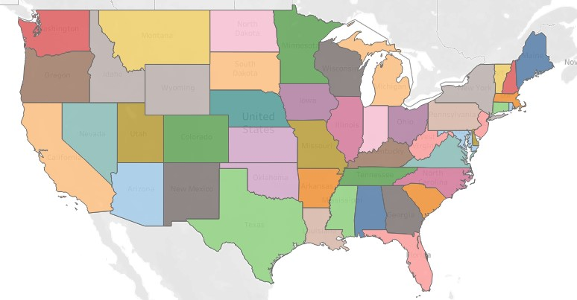
Tableau Geo and State Maps
Local organizations and Food recipients' quick views
Tableau interactivity allows for quick visuals for multiple data points across a large table.
By State meals served to support Child Nutrition
By County Food Banks and Excess Food
LINK

Slide 11
Sources

Slide 12
CRISPR-Cas9 is a method for quickly and accurately editing the genome of virtually any living thing. Using custom-built guide RNA paired with a cutting enzyme (Cas9), it can find and snip a selected sequence of DNA or RNA, eliminating or replacing a “bad” gene. Since it was first described, in late 2012, CRISPR has drastically accelerated the scope of research and moved into practical applications in medicine. So far in 2020, there are 15 trials underway. In medicine, where new drugs take a decade or more to develop, that’s game changing.
From <https://geneticliteracyproject.org/2020/06/12/infographic-what-crispr-is-curing-in-2020/>

